Slide 1
T-SQL
Using Functions and Expressions

Slide 2
Concatenating Strings
+ operator
Problems with null
CONCAT function

Slide 3
ISNULL and COALESCE
functions are available to replace NULL values with another value
ISNULL(<value>,<replacement>)
COALESCE(<value1>,<value2>,...,<valueN>)

Slide 4
Concatenating Other Data Types to Strings
CAST(<value> AS <new data type>)
CONVERT(<new data type>,<value>)

Slide 5
EXCERCISE
1. Write a query that displays in the “AddressLine1 (City PostalCode)” format from the Person.Address table.
2. Write a query using the Production.Product table displaying the product ID, color, and name columns. If the color column contains a NULL value, replace the color with No Color.
3. Modify the query written in question 2 so that the description of the product is displayed in the “Name: Color” format. Make sure that all rows display a value even if the Color value is missing.

Slide 6
Using Mathematical Operators
+, -, *, /
% modulo (number odd or even)

Slide 7
EXCERCISE
1. Write a query using the Sales.SpecialOffer table. Display the difference between the MinQty and MaxQty columns along with the SpecialOfferID and Description columns.
2. Write a query using the Sales.SpecialOffer table. Multiply the MinQty column by the DiscountPct column. Include the SpecialOfferID and Description columns in the results.
3. Write a query using the Sales.SpecialOffer table that multiplies the MaxQty column by the DiscountPct column. If the MaxQty value is NULL, replace it with the value 10. Include the SpecialOfferID and Description columns in the results.

Slide 8
Using String Functions
RTRIM(<string>)
LTRIM(<string>)
LEFT(<string>,<number of characters)
RIGHT(<string>,<number of characters)
LEN(<string>)
DATALENGTH(<string>) (nchar, nvarchar)

Slide 9
Using String Functions
CHARINDEX(<search string>,<target string>[,<start location>]): numeric starting position of a search string inside another string
SUBSTRING(<string>,<start location>,<length>)
CHOOSE ( index, val_1, val_2 [, val_n ] )
UPPER(<string>)
LOWER(<string>)
REPLACE(<string value>,<string to replace>,<replacement>)

Slide 10
USING STRING FUNCTIONS
STRING_SPLIT (It is important that the database is in compatibility level 130)
COMPRESS: The COMPRESS function is a scalar function and compresses the input variable, column, or expression using the GZIP algorithm.
DECOMPRESS: The result is in the binary format

Slide 11
Nesting Functions
LTRIM(RTRIM(' test '))
SUBSTRING AND CHARINDEX

Slide 12
EXCERCISE
1. Write a query that displays the first 10 characters of the AddressLine1 column in the Person.Address table.
2. Write a query that displays characters 10 to 15 of the AddressLine1 column in the Person.Address table.
3. Write a query displaying the first and last names from the Person.Person table all in uppercase.
4. The ProductNumber in the Production.Product table contains a hyphen (-). Write a query that uses the SUBSTRING function and the CHARINDEX function to display the characters in the product number following the hyphen. Note: there is also a second hyphen in many of the rows; ignore the second hyphen for this question. Hint: Try writing this statement in two steps, the first using the CHARINDEX function and the second adding the SUBSTRING function.

Slide 13
Using Date Functions
GETDATE
SYSDATETIME
DATEADD(<date part>,<number>,<date>)
DATEDIFF(<datepart>,<early date>,<later date>)
DATENAME(<datepart>,<date>)
DATEPART(<datepart>,<date>)
DAY(<date>)
MONTH(<date>)
YEAR(<date>)

Slide 14
Using Date Functions
CONVERT(<data type, usually varchar>,<date>,<style>)
The CONVERT function has an optional parameter called style that can be used to format a date.

Slide 15
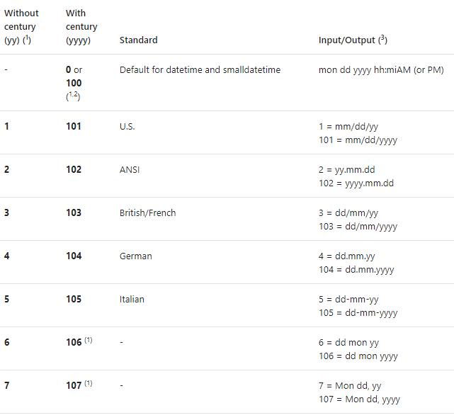

Slide 16
Using Date Functions
FORMAT ( value, format [, culture ] )
The FORMAT function greatly simplifies how date/time values are converted, and it should be used for date/time values instead of the CAST or CONVERT functions.
DATEFROMPARTS
TIMEFROMPARTS
DATETIME2FROMPARTS

Slide 17
1. Write a query that calculates the number of days between the date an order was placed and the date that it was shipped using the Sales.SalesOrderHeader table. Include the SalesOrderID, OrderDate, and ShipDate columns.
2. Write a query that displays only the date, not the time, for the order date and ship date in the Sales.SalesOrderHeader table.
3. Write a query that adds six months to each order date in the Sales.SalesOrderHeader table. Include the SalesOrderID and OrderDate columns.
4. Write a query that displays the year of each order date and the numeric month of each order date in separate columns in the results. Include the SalesOrderID and OrderDate columns.
5. Change the query written in question 4 to display the month name instead.

Slide 18
Using Mathematical Functions
ABS
POWER(<number>,<power>)
SQUARE
SQRT
ROUND(<number>,<length>[,<function>])
RAND

Slide 19
CREATE TSQLV4
TSQLV4.SQL file

Slide 20
System Functions
Simple CASE: CASE <test expression> WHEN <comparison expression1> THEN <return value1>
WHEN <comparison expression2> THEN <return value2>
[ELSE <value3>] END
Searched CASE: CASE WHEN <test expression1> THEN <value1>
WHEN <test expression2> THEN <value2>
[ELSE <value3>] END

Slide 21
System Functions
Listing a Column as the Return Value
IIF ( boolean_expression, true_value, false_value )
Admin Functions
@@ROWCOUNT and ROWCOUNT_BIG (returns the number of rows affected by the last statement that you executed)
newid

Slide 22
EXCERCISE
1. Write a query using the HumanResources.Employee table to display the BusinessEntityID column. Also include a CASE statement that displays “Even” when the BusinessEntityID value is an even number or “Odd” when it is odd. Hint: Use the modulo operator.
2. Write a query using the Sales.SalesOrderDetail table to display a value (“Under 10” or “10–19” or “20–29” or “30–39” or “40 and over” ) based on the OrderQty value by using the CASE function. Include the SalesOrderID and OrderQty columns in the results.
3. Look up the SERVERPROPERTY function in Books Online. Write a statement that displays the edition, instance name, and machine name using this function.

Slide 23
Using Functions in the WHERE and ORDER BY Clauses
You may also use functions in the WHERE and ORDER BY clauses

Slide 24
The TOP Keyword
SELECT TOP(<number>) [PERCENT] [WITH TIES] <col1>,<col2> FROM <table1> [ORDER BY <col1>]
DELETE TOP(<number>) [PERCENT] [FROM] <table1>
UPDATE TOP(<number>) [PERCENT] <table1> SET <col1> = <value>
INSERT TOP(<number>) [PERCENT] [INTO] <table1> (<col1>,<col2>)
SELECT <col3>,<col4> FROM <table2>
INSERT [INTO] <table1> (<col1>,<col2>)
SELECT TOP(<numbers>) [PERCENT] <col3>,<col4>
FROM <table2>
ORDER BY <col1>

Slide 25
The TOP Keyword
The ORDER BY clause is not valid with DELETE and UPDATE.
The WITH TIES option is valid only with the SELECT statement. It means that, if there are rows that have identical values in the ORDER BY clause, the results will include all the rows even though you now end up with more rows than you expect.
T-SQL supports specifying the number of rows to filter using the TOP option in SELECT queries without parentheses, but that’s only for backward-compatibility reasons. The correct syntax is with parentheses.
In terms of logical query processing, the TOP and OFFSET-FETCH filters are processed after the FROM, WHERE, GROUP, HAVING and SELECT phases. You can consider these filters as being an extension to the ORDER BY clause.

Slide 26
Ranking functions
ROW_NUMBER
ROW_NUMBER function contains the OVER clause, which the function uses to determine the numbering behavior.
You have the option of starting the numbers over whenever the values of a specified column change, called partitioning, with the PARTITION BY clause

Slide 27
Ranking functions row_number
SELECT <col1>,<col2>, ROW_NUMBER() OVER([PARTITION BY <col1>,<col2>] ORDER BY <col1>,<col2>) AS <RNalias>
FROM <table1>
WITH <cteName> AS (
SELECT <col1>,<col2>,
ROW_NUMBER() OVER([PARTITION BY <col1>,<col2>] ORDER BY <col1>,<col2>) AS <RNalias>
FROM <table1>)
SELECT <col1>,<col2>,<RNalias>
FROM <table1>
WHERE <criteria including RNalias>

Slide 28
Ranking functions RANK and DENSE_RANK
RANK and DENSE_RANK are very similar to ROW_NUMBER. The difference is how the functions deal with ties in the ORDER BY values.
RANK assigns the same number to the duplicate rows and skips numbers not used.
DENSE_RANK doesn’t skip numbers
SELECT <col1>, RANK() OVER([PARTITION BY <col2>,<col3>] ORDER BY <col1>,<col2>)
frOM <table1>
SELECT <col2>, DENSE_RANK() OVER([PARTITION BY <col2>,<col3>]
ORDER BY <col1>,<col2>)
FROM <table1>

Slide 29
Ranking functions NTILE
While the other ranking functions supply a row number or rank to each row, the NTILE function assigns buckets to groups of rows
SELECT <col1>, NTILE(<buckets>) OVER([PARTITION BY <col1>,<col1>]
ORDER BY <col1>,<col2>) AS <alias>
FROM <table1>

Slide 30
COMBINING SETS WITH SET OPERATORS
UNION
UNION ALL
INTERSECT
EXCEPT
<query 1>
<operator>
<query 2>
[ORDER BY <order_by_list>];

Slide 31
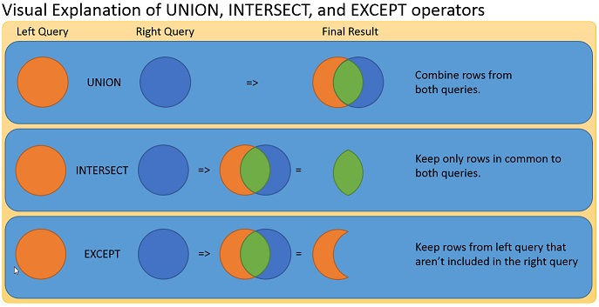

Slide 32
COMBINING SETS WITH SET OPERATORS
Because complete rows are matched between the result sets, the number of columns in the queries has to be the same and the column types of corresponding columns need to be compatible (implicitly convertible).
These operators use distinctness-based comparison and not equality based. Consequently, a comparison between two NULLs yields true, and a comparison between a NULL and a non-NULL value yields a false. This is in contrast to filtering clauses like WHERE, ON, and HAVING, which yield unknown when comparing a NULL with anything using both equality and inequality operators.

Slide 33
COMBINING SETS WITH SET OPERATORS
Because these operators are set operators and not cursor operators, the individual queries are not allowed to have ORDER BY clauses.
You can optionally add an ORDER BY clause that determines presentation ordering ordering of the result of the set operator.
The column names of result columns are determined by the first query.

Slide 34
COMBINING SETS WITH SET OPERATORS
The UNION operator unifies the results of the two input queries. As a set operator, UNION has an implied DISTINCT property, meaning that it does not return duplicate rows.

